Slide 1

Coordinated Resource Extraction
Deep Q-Networks for centralized cooperative multi-agent reinforcement learning
Emil G. Stålvinge, Anders Köhler & Julián R. Marrades

Slide 2
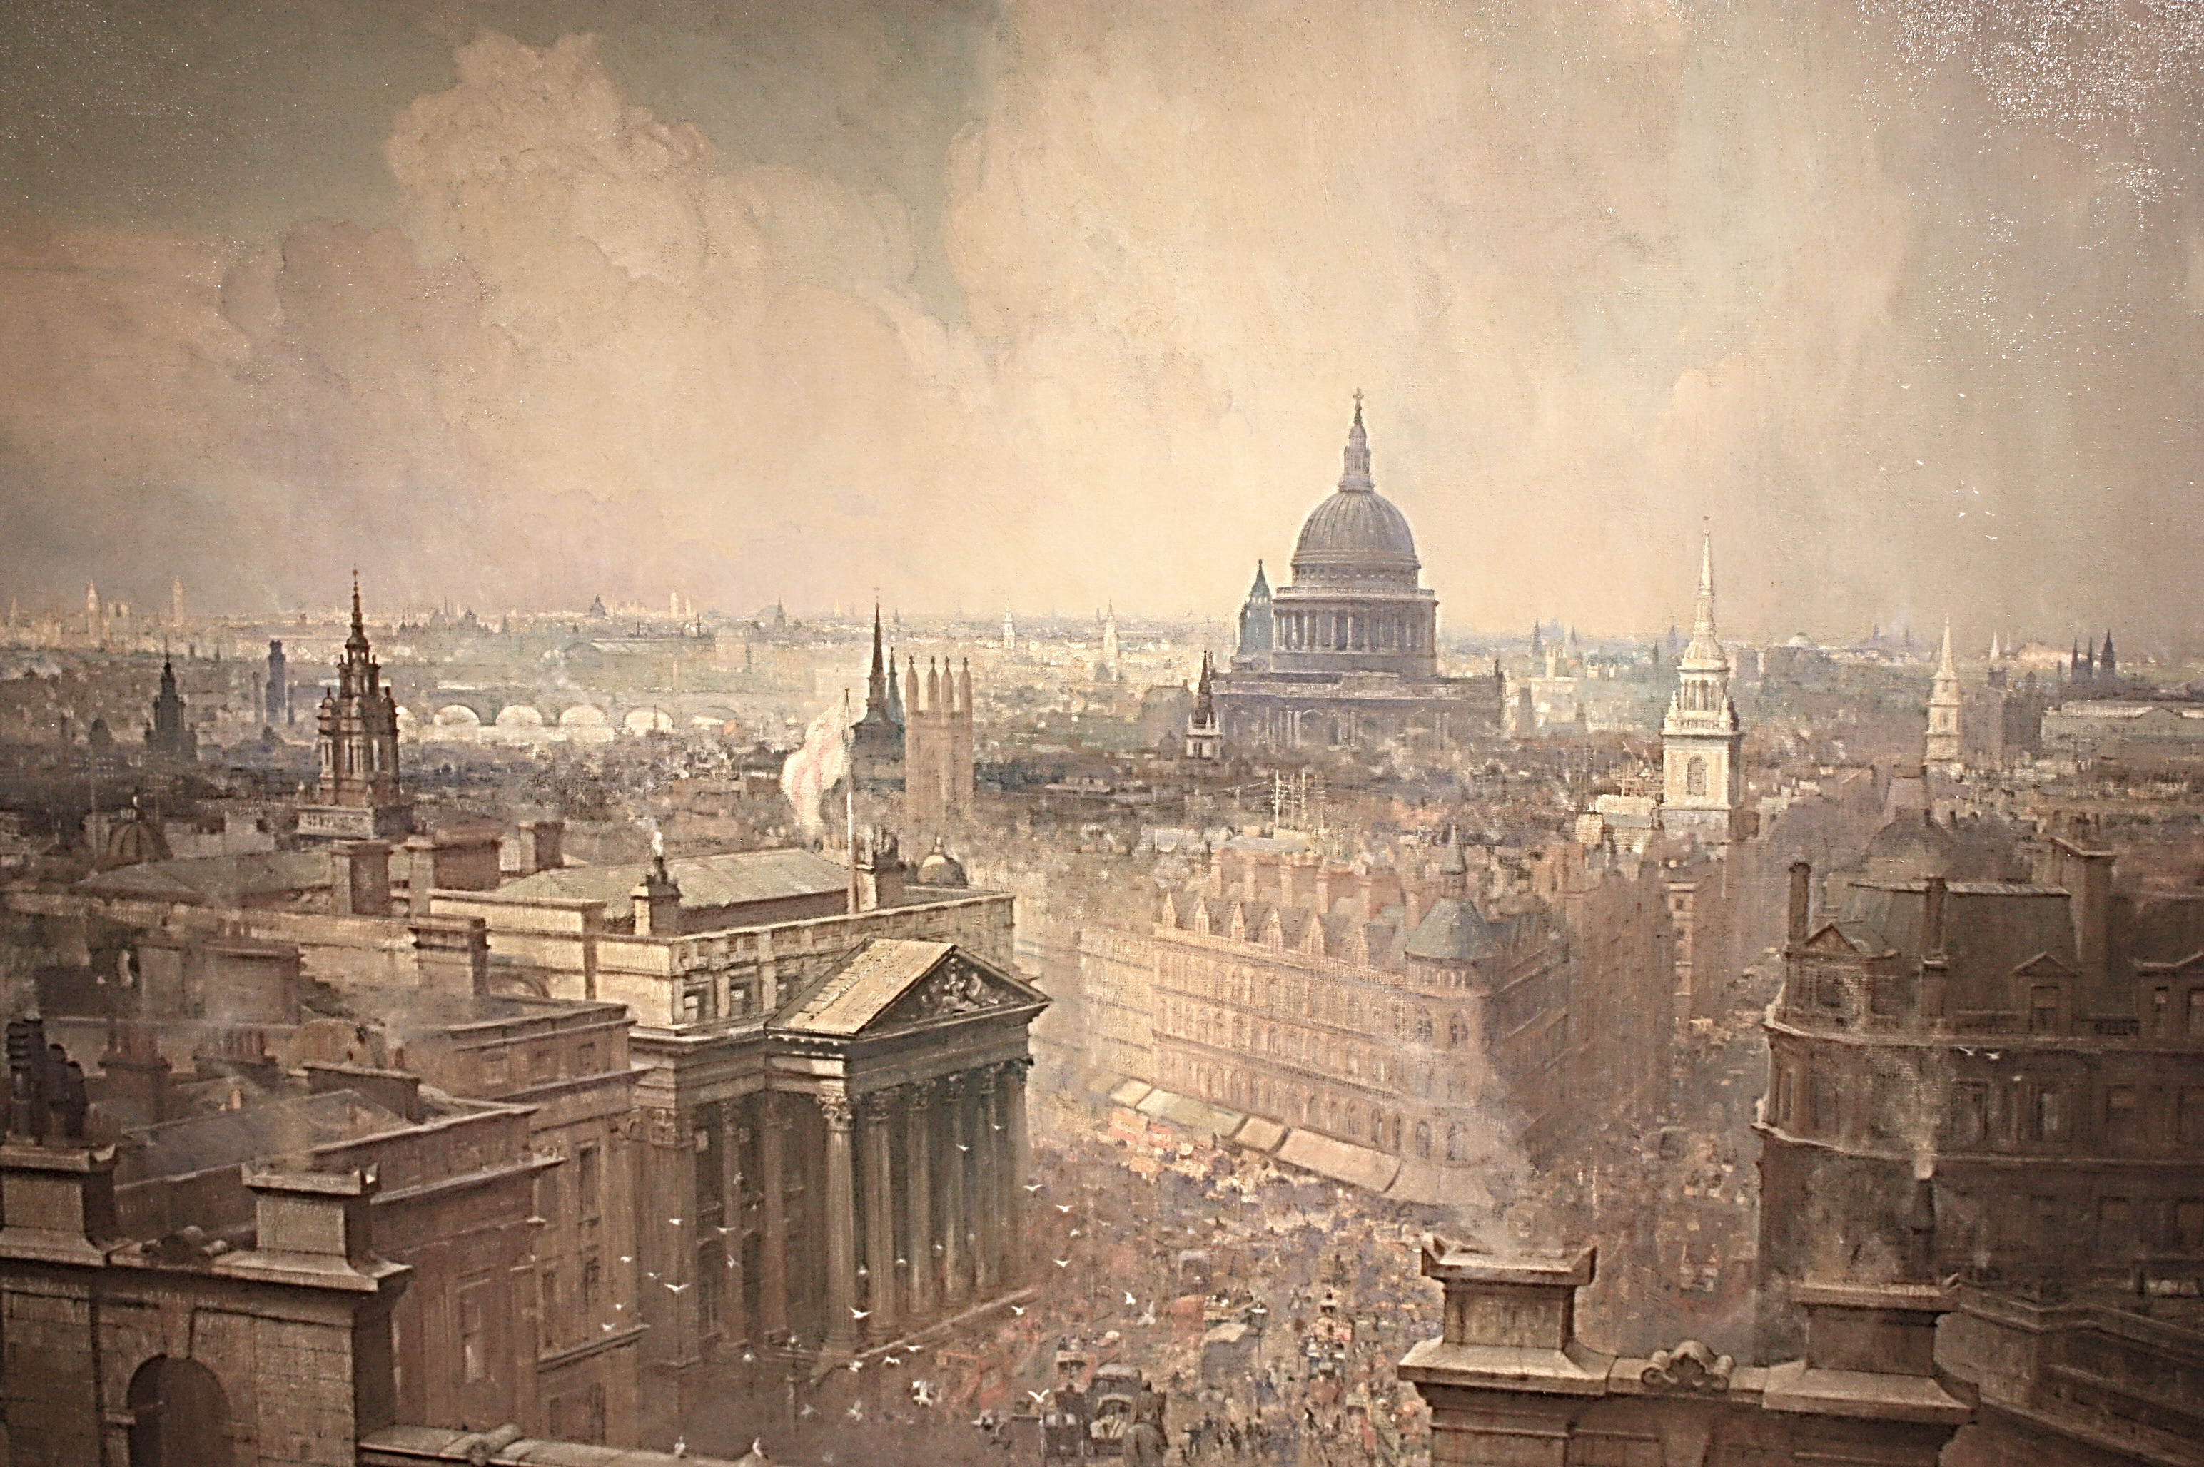
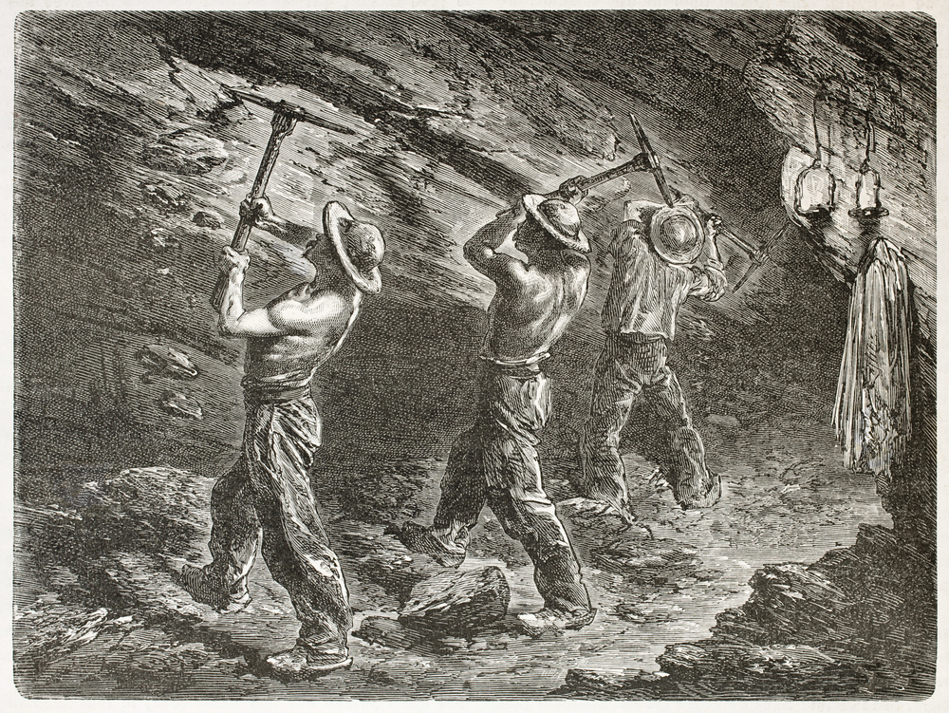
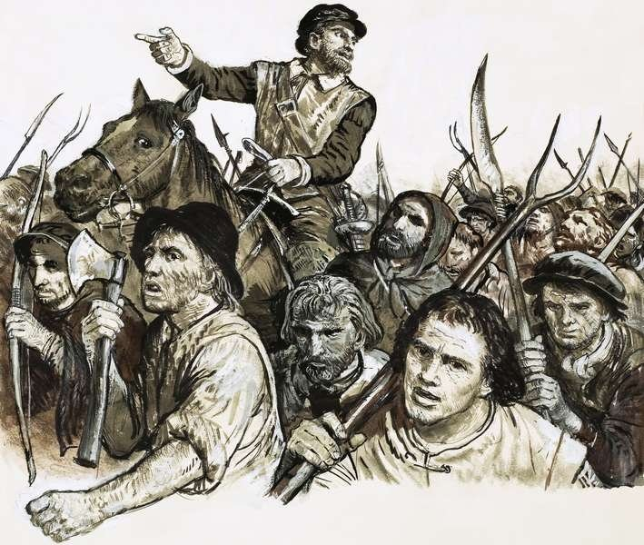
The State
The Labor
The Riot
How can we model this?

Slide 3

The game
$$p=1$$
Resource
Circle of influence
Enforcer
Civilian

Slide 4
The game
$$p=1$$
Resource
Circle of influence
Enforcer
Civilian

Slide 5
The game
$$p=1$$
Resource
Circle of influence
Enforcer
Civilian

Slide 6
Single-Agent RL
Multi-Agent RL

Slide 7


SARL
MARL
Given
$A$, $S$
$δ:S×A→S$
$ℛ:S×A→ℝ$
Find $π$ so that
$$V^{π}\left(s_{t}\right)≔\sum_{i=1}^{∞}{γ^{i}∙r_{t+i}}$$
is maximized
Let $m$ be the number of agents
$S$ grows exponentially with $m$
$A≔A_{1}×A_{2}×⋯×A_{n}$
$δ:S×A_{1}×A_{2}×⋯×A_{n}→S$
$ℛ:S×A_{1}×A_{2}×⋯×A_{n}→ℝ$ or $ℝ^{m}$
$δ:S×A_{1}×A_{2}×⋯×A_{n}→S$ may not always lead to the same state for a given $A_{i}$

Slide 8
Deep Q-Networks (DQNs)
Why?
Not enough storage for Q-table
Can’t visit all states
You have a 3080 Ti
Need more funding
Want to use linear activation
s₁
Q(s, a₁)
s₂
Q(s, a₂)
s₃
Notes:
Need more funding because you spent it in the 3080 Ti

Slide 9
Deep Q-Networks (DQNs)
Why?
Not enough storage for Q-table
Can’t visit all states
You have a 3080 Ti
Need more funding
Want to use linear activation
s₁
Q(s, a₁)
s₂
Q(s, a₂)
s₃
Notes:
Need more funding because you spent it in the 3080 Ti

Slide 10
MARL to SARL

Slide 11

MARL to SARL
$$A=\left[0, 1, 2, 3, 4\right]$$
$$size\left(A\right)=5$$

Slide 12


MARL to SARL
$$A=\left[0, 1, 2, 3, 4\right]$$
$$size\left(A\right)=5$$
$$A=\left[\left(0, 0\right), \left(0, 1\right), \left(0, 2\right), …\right]$$
$$size\left(A\right)=5^{2}=25$$

Slide 13

MARL to SARL
$$A=\left[0, 1, 2, 3, 4\right]$$
$$size\left(A\right)=5$$
$$A=\left[\left(0, 0\right), \left(0, 1\right), \left(0, 2\right), …\right]$$
$$size\left(A\right)=5^{2}=25$$
$$A=\left[\left(0, 0, 0\right), \left(0, 0, 1\right),…\right]$$
$$size\left(A\right)=5^{3}=125$$

Slide 14

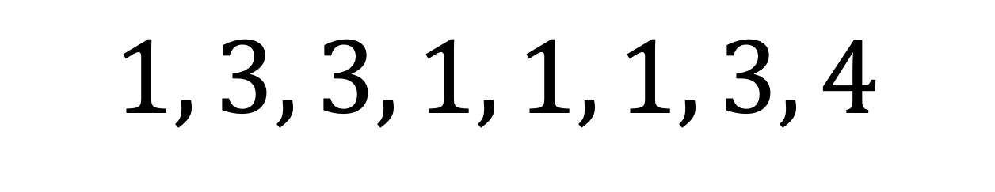

















v1.0 & v1.5
$$g=5$$
C
M
v1.0
$$4$$
$$1, 3,$$
$$3, 1,$$
$$1, 1,$$
$$3, 4$$
$$[ 1, 3, 3, 1, 1, 1, 3, 4 ]$$
$$3$$
$$2$$
v1.5
$$[ 1, 3, 3, 1, 1, 1, 3, 4 ]$$
$$1$$
$$g−1$$
$$0$$
$$0$$
$$1$$
$$2$$
$$3$$
$$4$$
$$[ 0.25, 0.75, 0.75, 0.25, 0.25, 0.25, 0.75, 1 ]$$

Slide 15
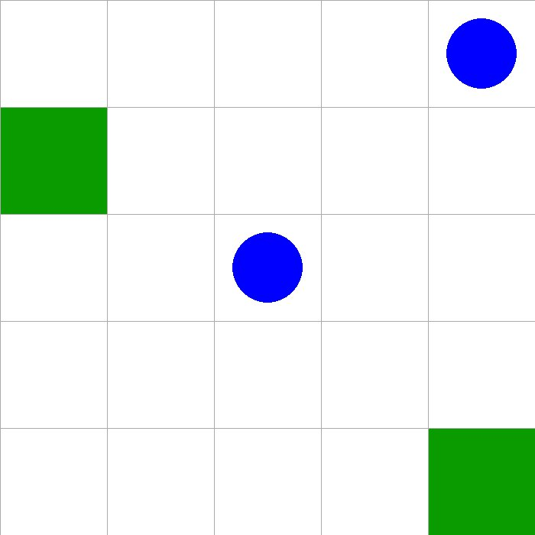

Slide 16
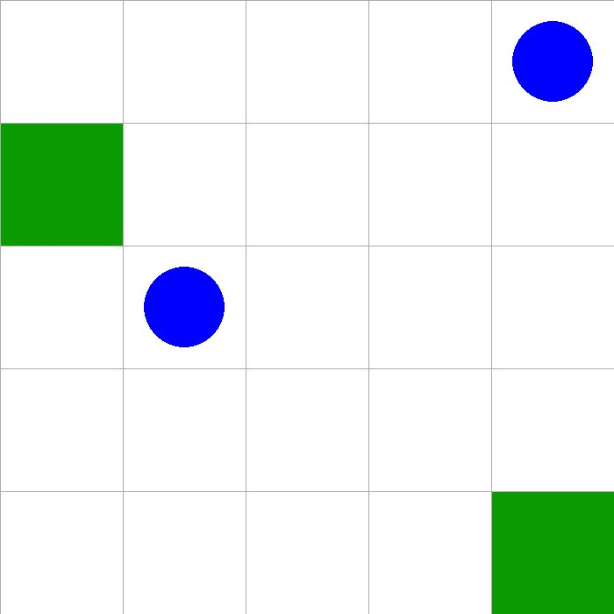

Slide 17
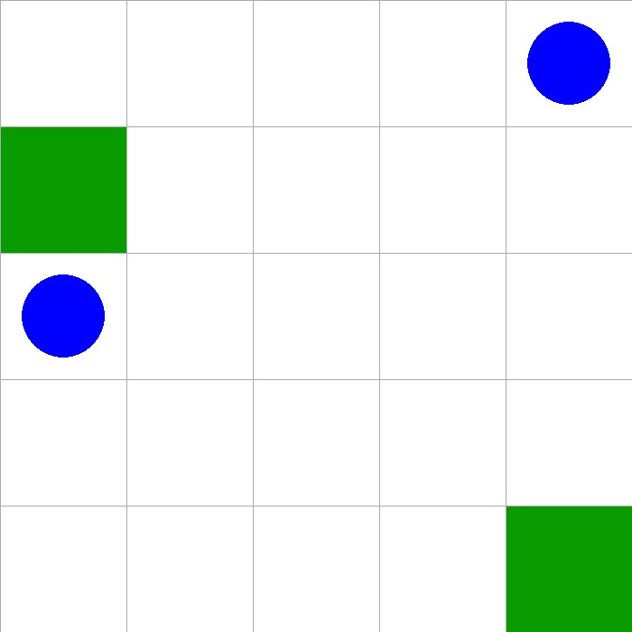

Slide 18
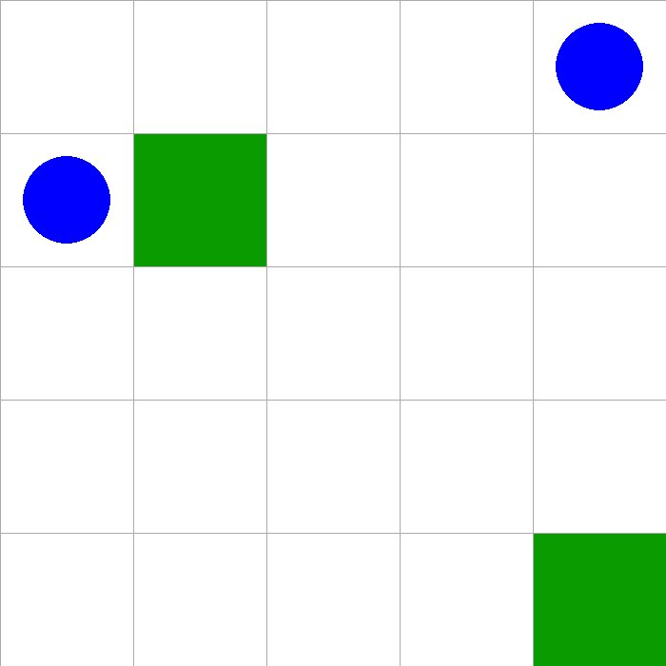

Slide 19
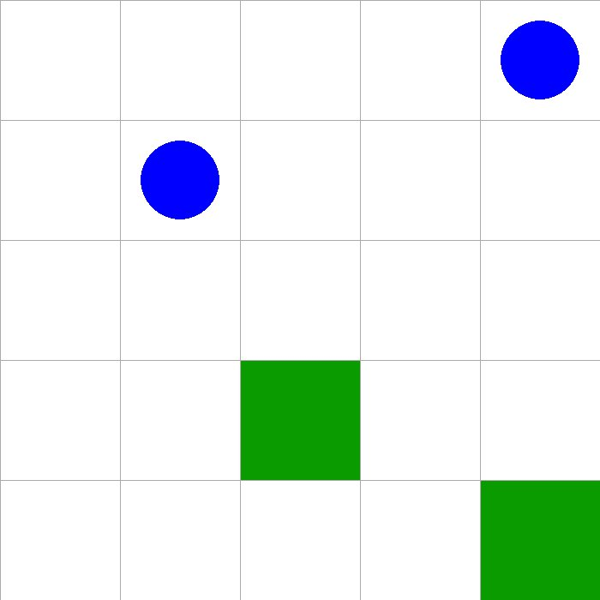

Slide 20
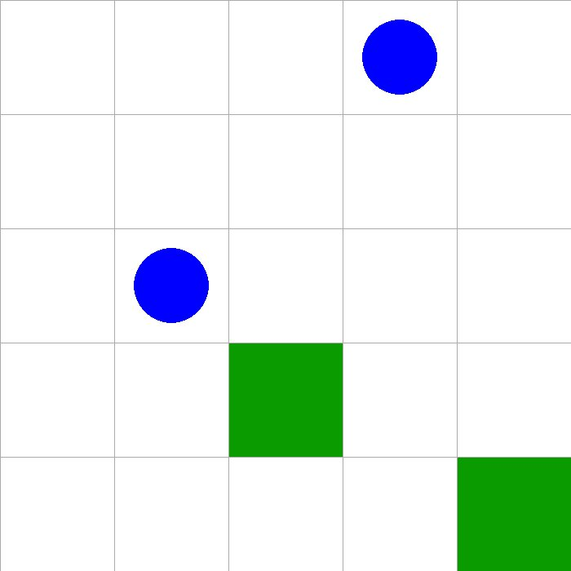

Slide 21
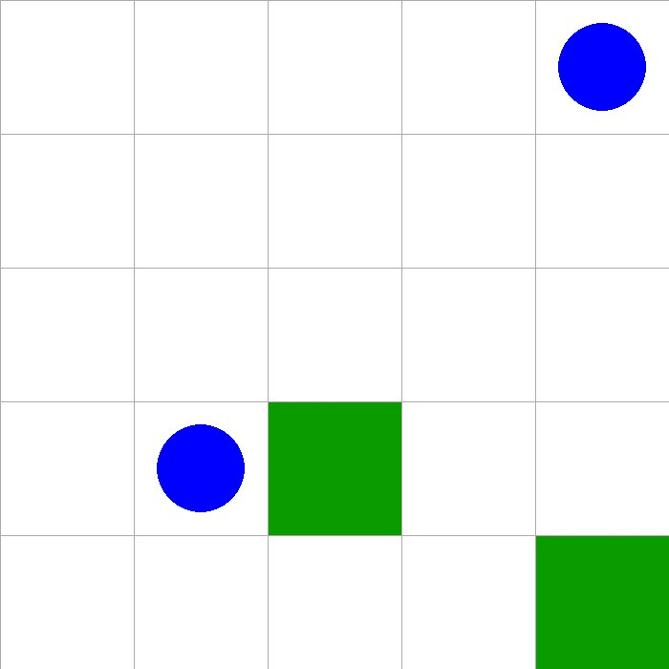

Slide 22
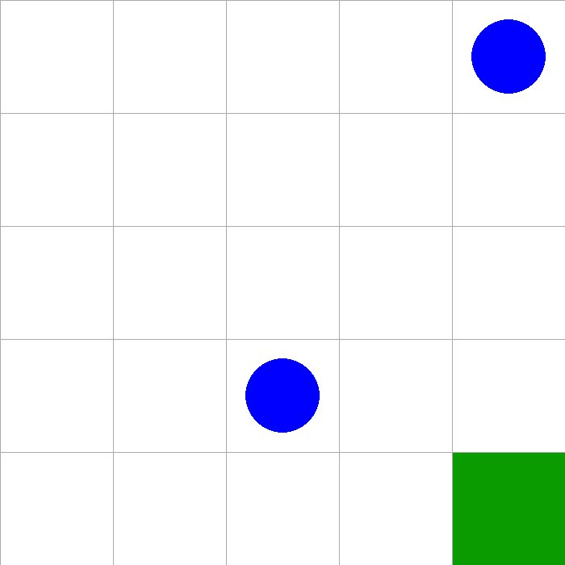

Slide 23
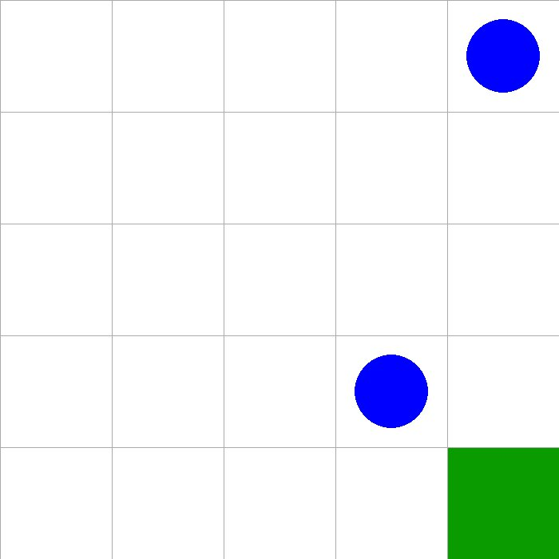

Slide 24
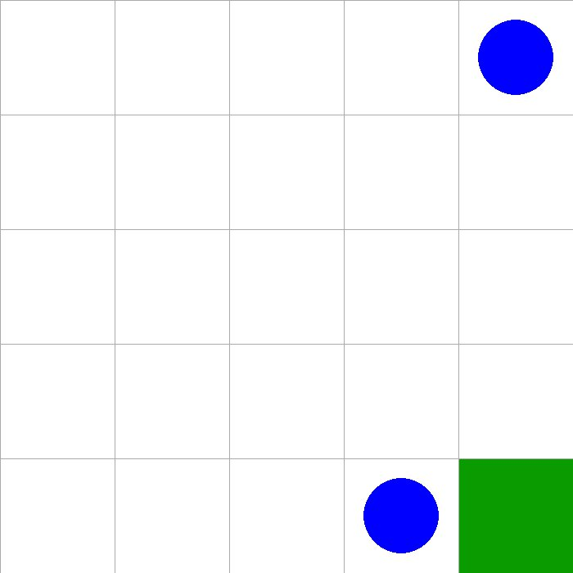

Slide 25





v2.0 & v2.5
$$g=5$$
$$I=1$$
$$p=1$$
v2.0
$$4$$
$$[ C, M, N ]$$
$$3$$
$$2$$
v2.5
$$[ 1, 3, 2, 3, 1, 2, 1, 1, 3, 4 ]$$
$$1$$
$$0$$
$$0$$
$$1$$
$$2$$
$$3$$
$$4$$

Slide 26
v2.0 & v2.5
$$g=5$$
$$I=1$$
$$p=1$$
v2.0
$$4$$
$$[ C, M, N ]$$
$$3$$
$$2$$
v2.5
$$[ 1, 3, 2, 3, 1, 2, 1, 1, 3, 4 ]$$
$$1$$
$$0$$
$$0$$
$$1$$
$$2$$
$$3$$
$$4$$

Slide 27
v2.0 & v2.5
$$g=5$$
$$I=1$$
$$p=1$$
v2.0
$$4$$
$$[ C, M, N ]$$
$$3$$
$$2$$
v2.5
$$[ 1, 3, 2, 3, 1, 2, 1, 1, 3, 4 ]$$
$$1$$
$$0$$
$$0$$
$$1$$
$$2$$
$$3$$
$$4$$

Slide 28
v2.0 & v2.5
$$g=5$$
$$I=1$$
$$p=1$$
v2.0
$$4$$
$$[ C, M, N ]$$
$$3$$
$$2$$
v2.5
$$[ 1, 3, 2, 3, 1, 2, 1, 1, 3, 4 ]$$
$$1$$
$$0$$
$$0$$
$$1$$
$$2$$
$$3$$
$$4$$

Slide 29
v2.0 & v2.5
$$g=5$$
$$I=1$$
$$p=1$$
v2.0
$$4$$
$$[ C, M, N ]$$
$$3$$
$$2$$
v2.5
$$[ 1, 3, 2, 3, 1, 2, 1, 1, 3, 4 ]$$
$$1$$
$$0$$
Normalize!
$$0$$
$$1$$
$$2$$
$$3$$
$$4$$

Slide 30
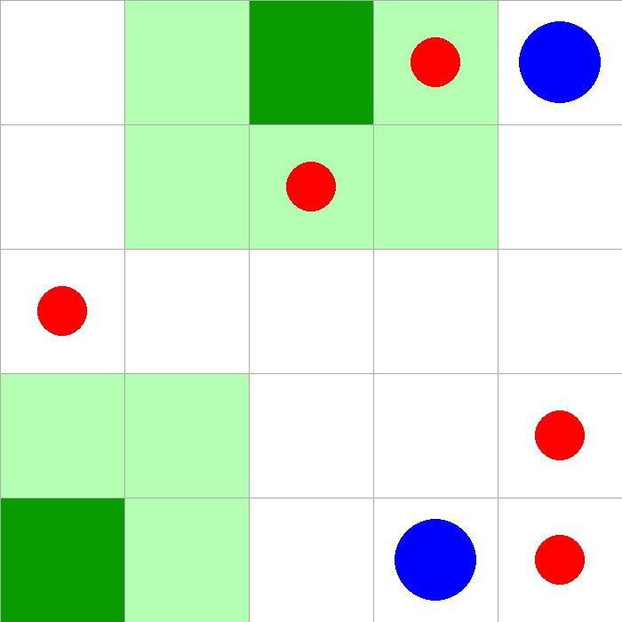

Slide 31
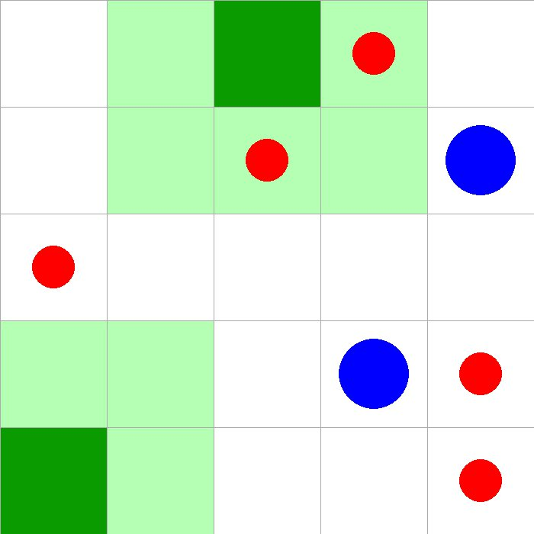

Slide 32
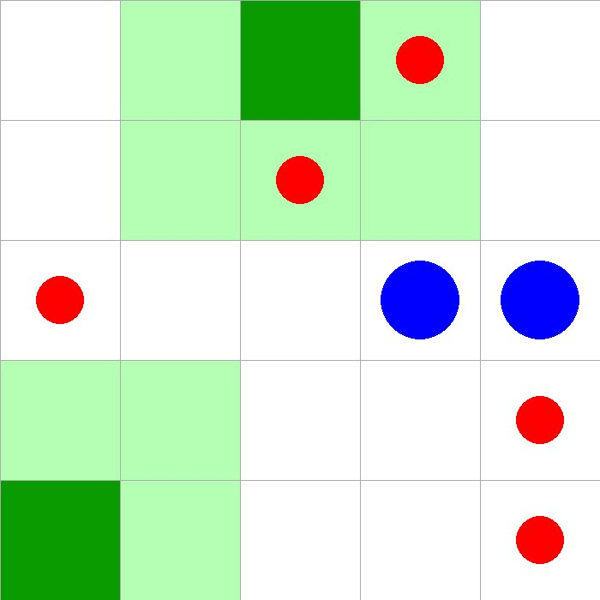

Slide 33
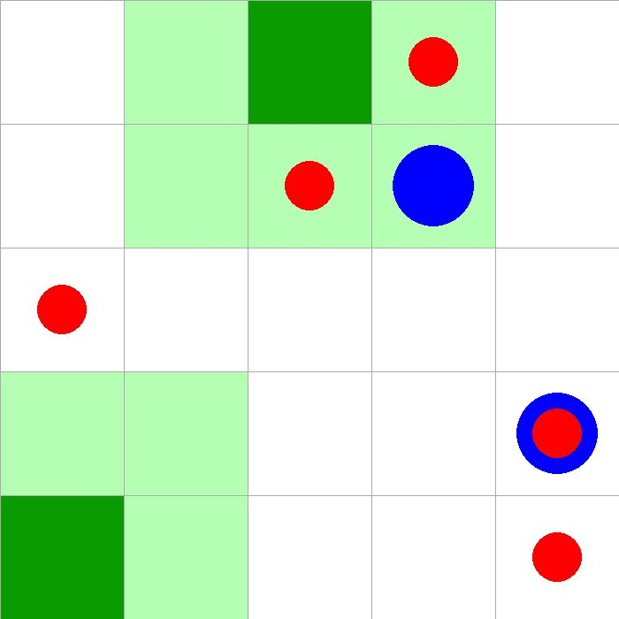

Slide 34
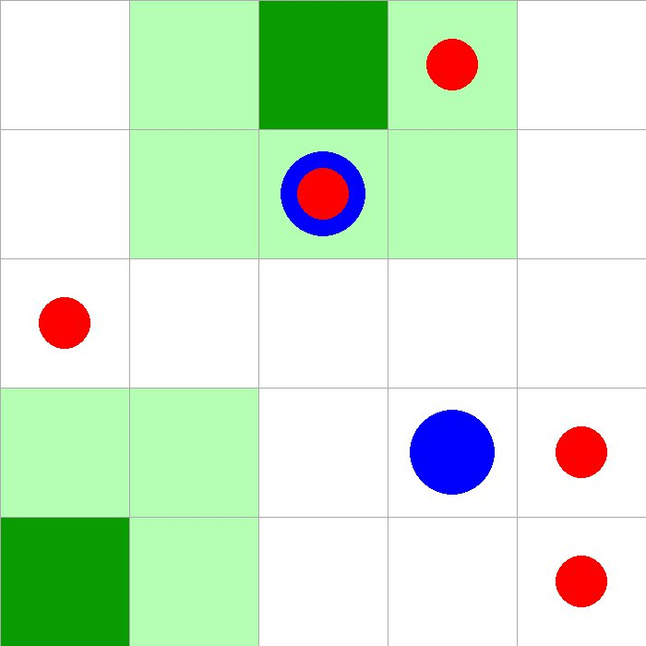

Slide 35
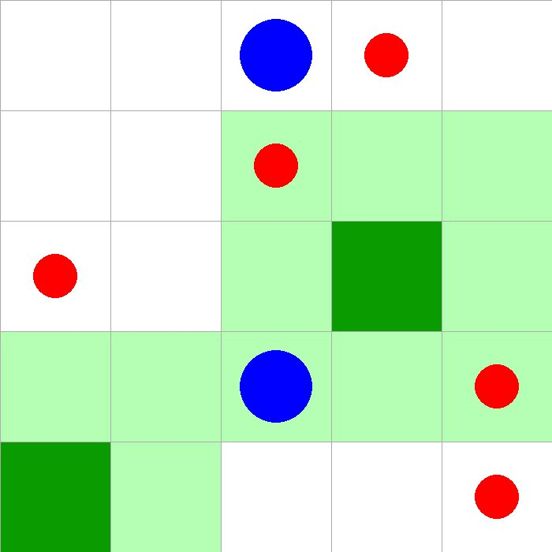

Slide 36
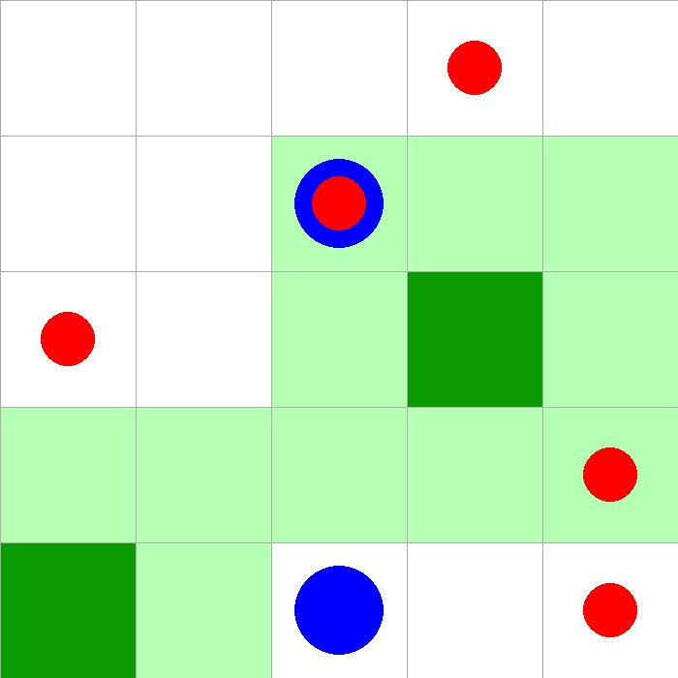

Slide 37
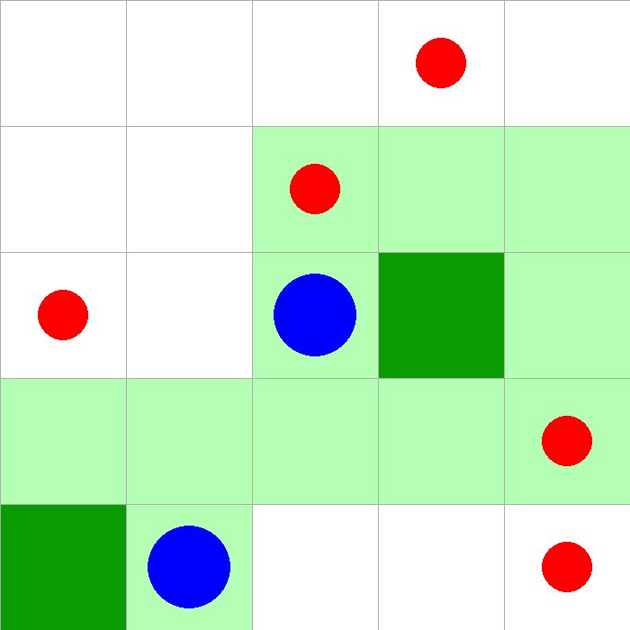

Slide 38
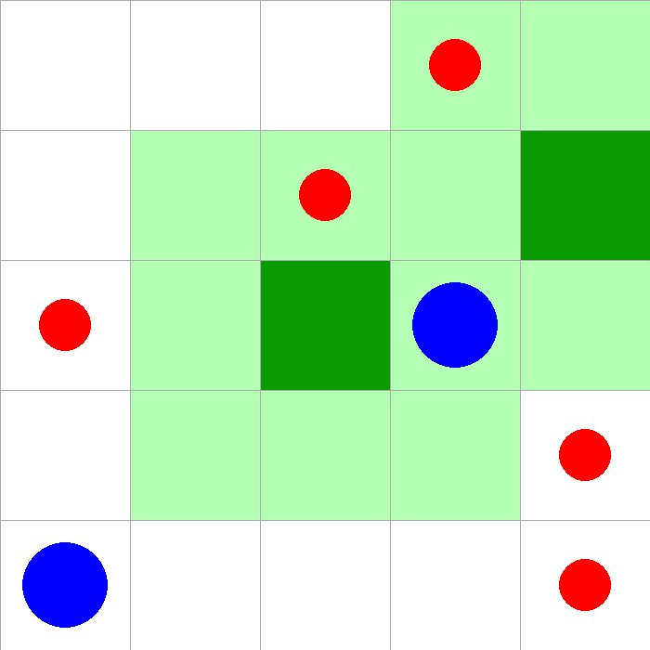

Slide 40
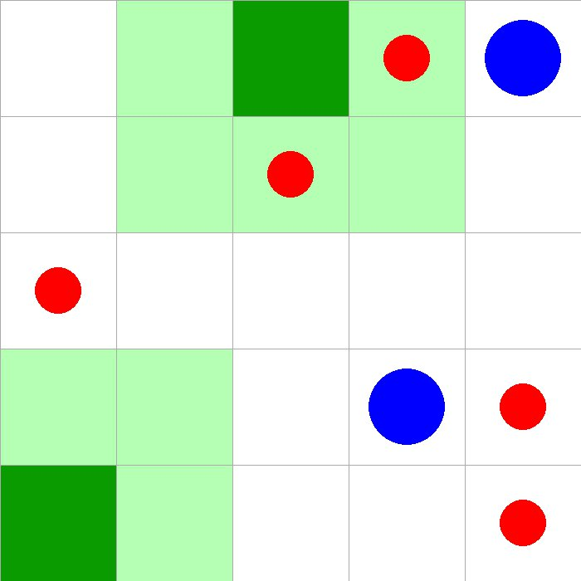

Slide 41
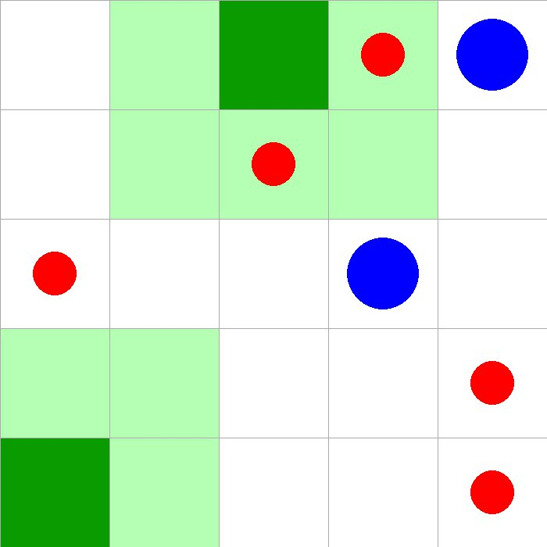

Slide 42
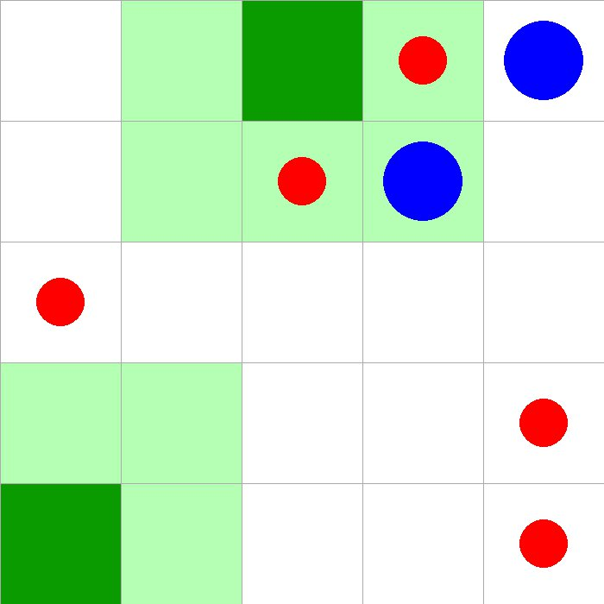

Slide 43
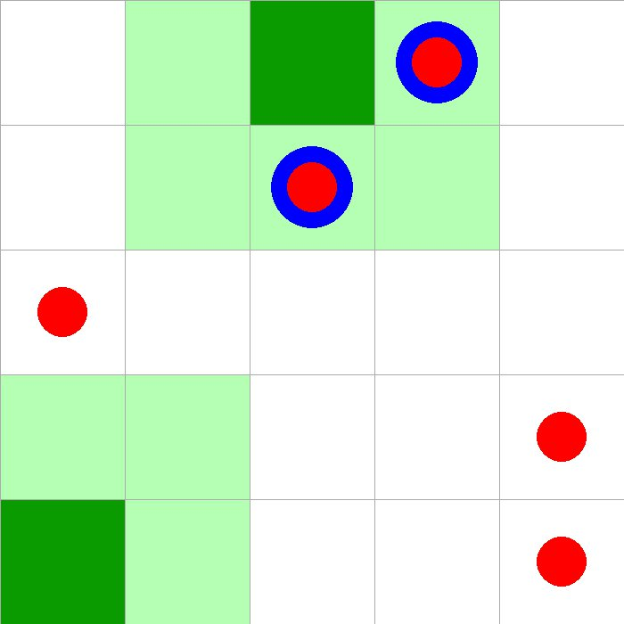

Slide 44
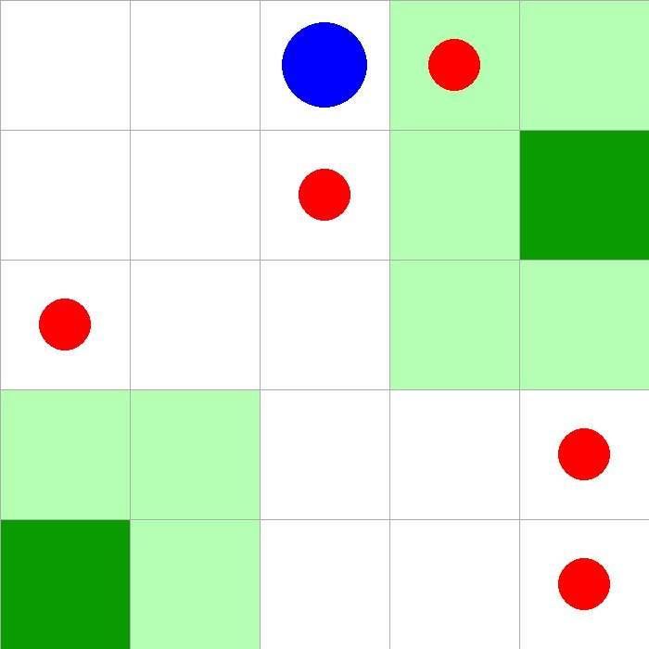

Slide 45
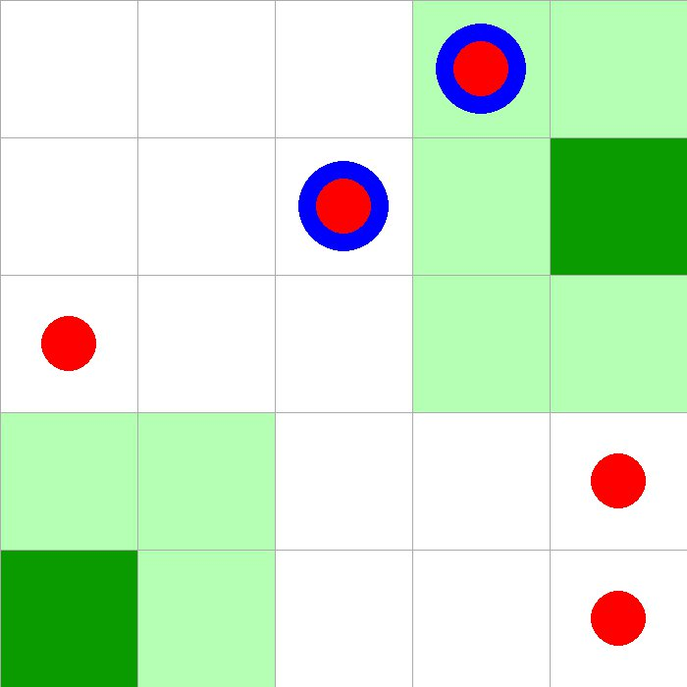

Slide 46
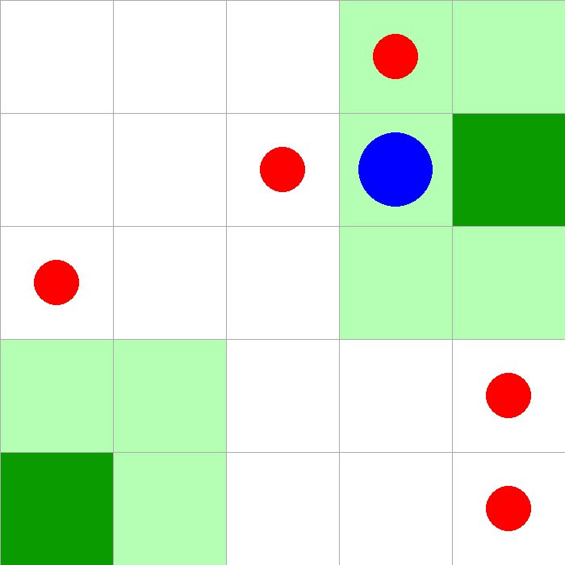

Slide 47
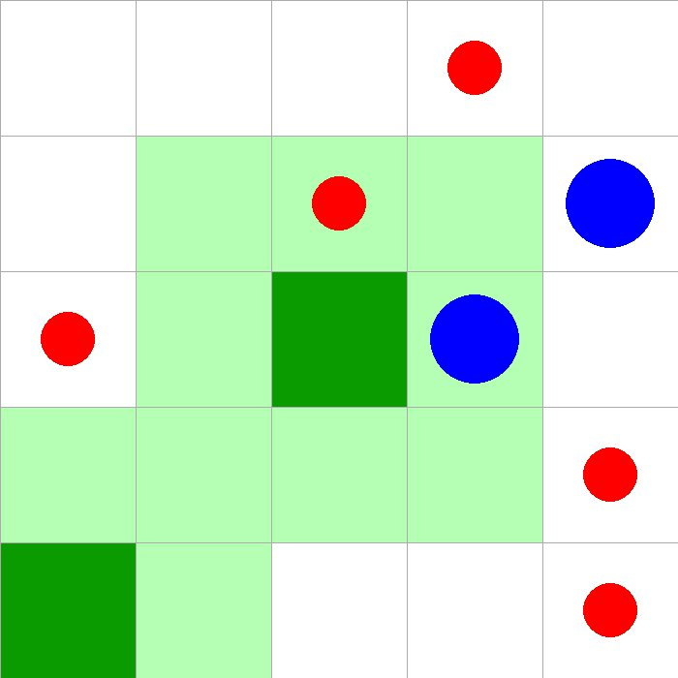

Slide 48
v3.0 & v3.5
$$g=5$$
$$I=1$$
$$p=1$$
$$4$$
$$3$$
$$2$$
$$1$$
$$0$$
$$0$$
$$1$$
$$2$$
$$3$$
$$4$$

Slide 49


v3.0 & v3.5
$$g=5$$
$$I=1$$
$$p=1$$
v3.0
$$4$$
$$[ 1, 3, 2, −1, −1, 0, 1, 1, 3, 4 ]$$
$$3$$
Normalize!
$$2$$
v3.5
$$1$$
$$[ 1, 3, 0, 2, 3, 1, 1, 0, 1, 1, 3, 4 ]$$
$$0$$
Normalize!
$$0$$
$$1$$
$$2$$
$$3$$
$$4$$

Slide 50
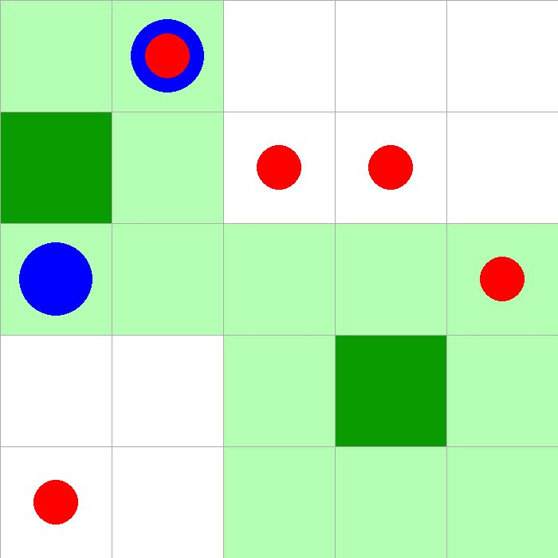

Slide 51
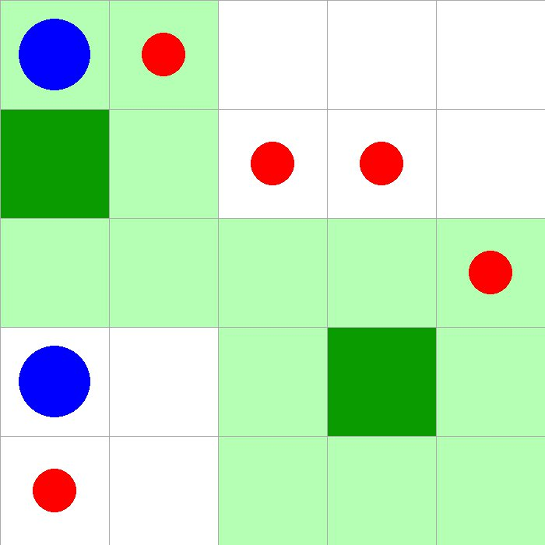

Slide 52
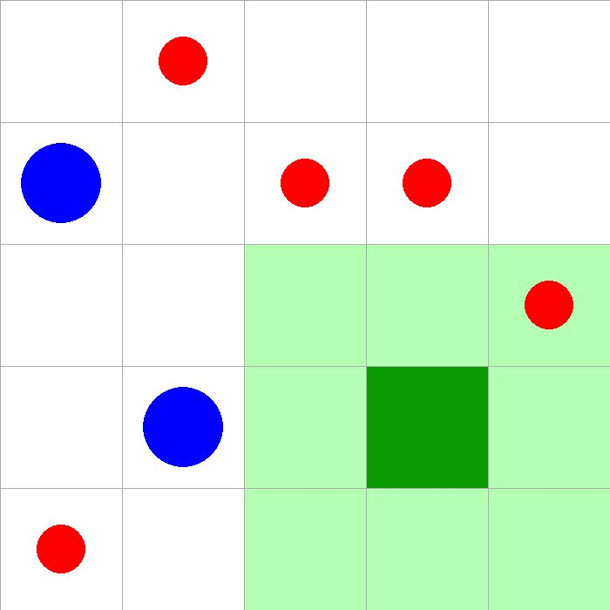

Slide 53
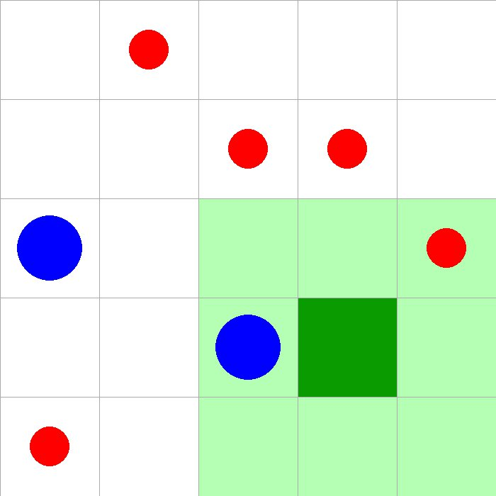

Slide 54
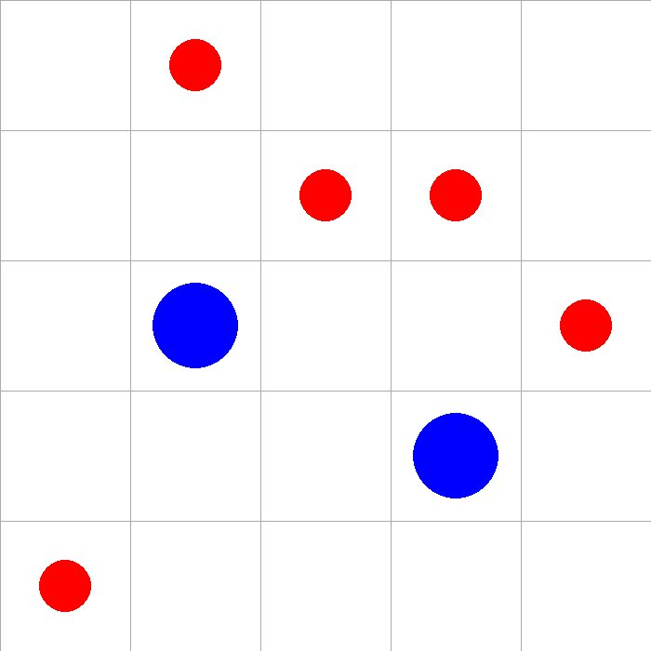

Slide 55
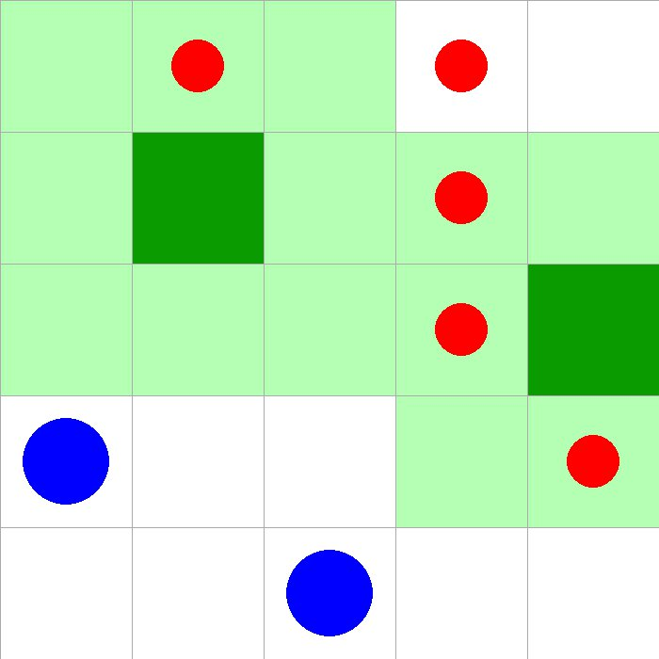

Slide 56
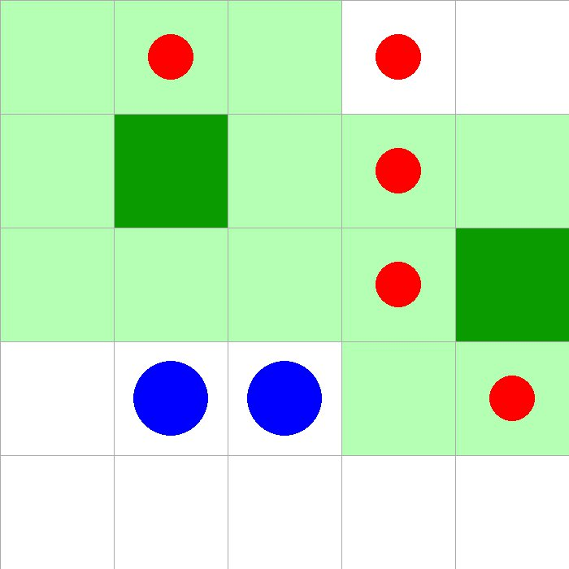

Slide 57
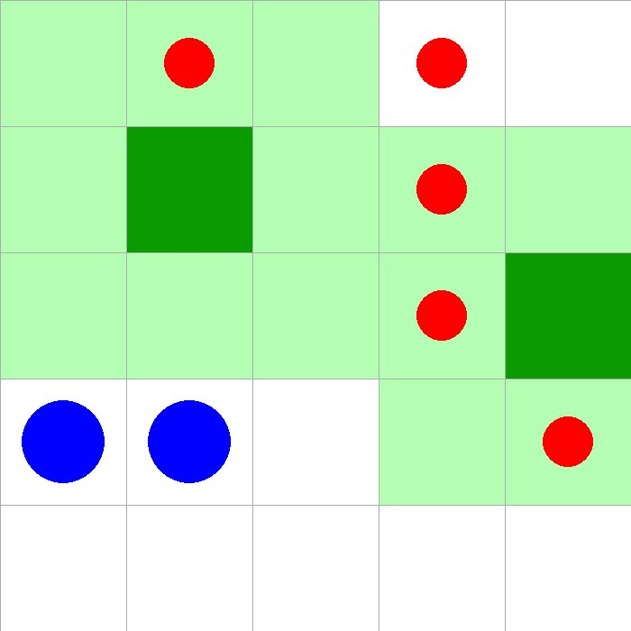

Slide 58
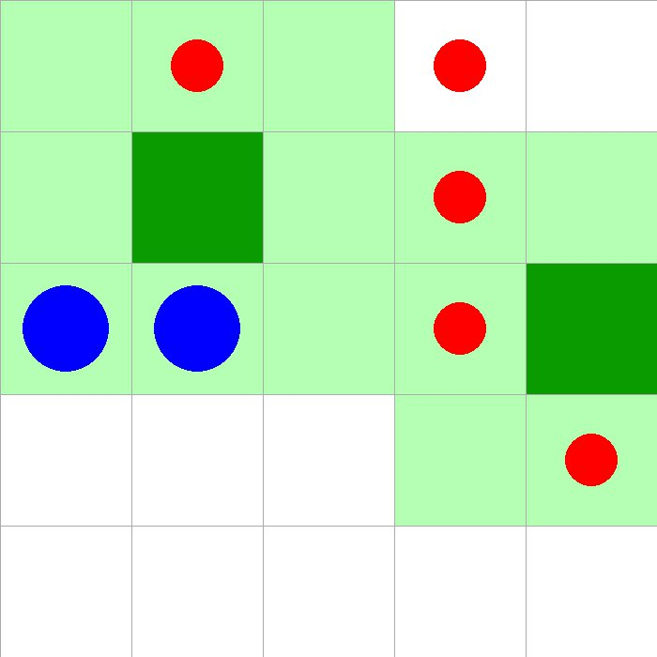

Slide 59
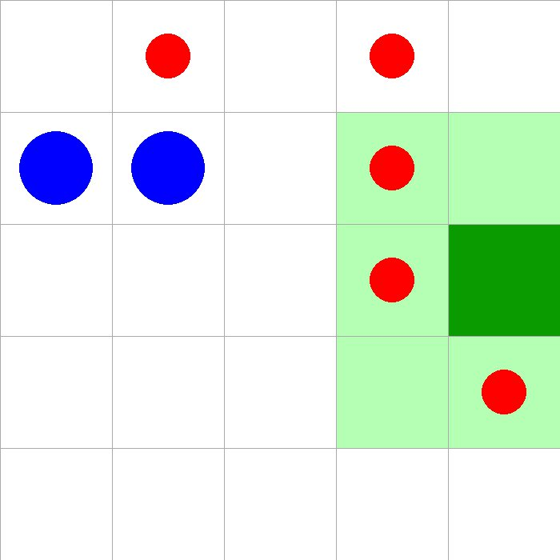

Slide 60
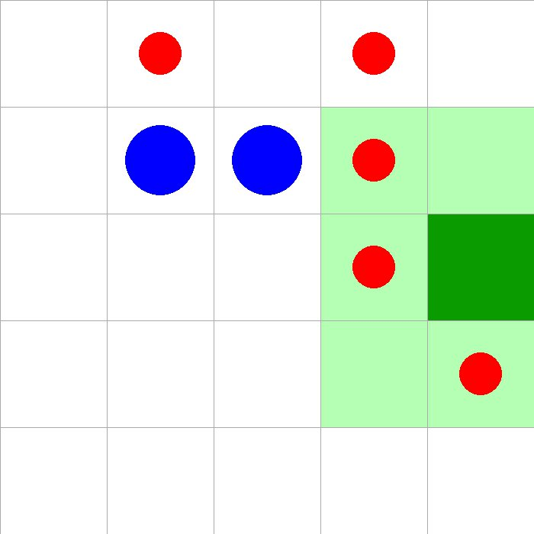

Slide 61
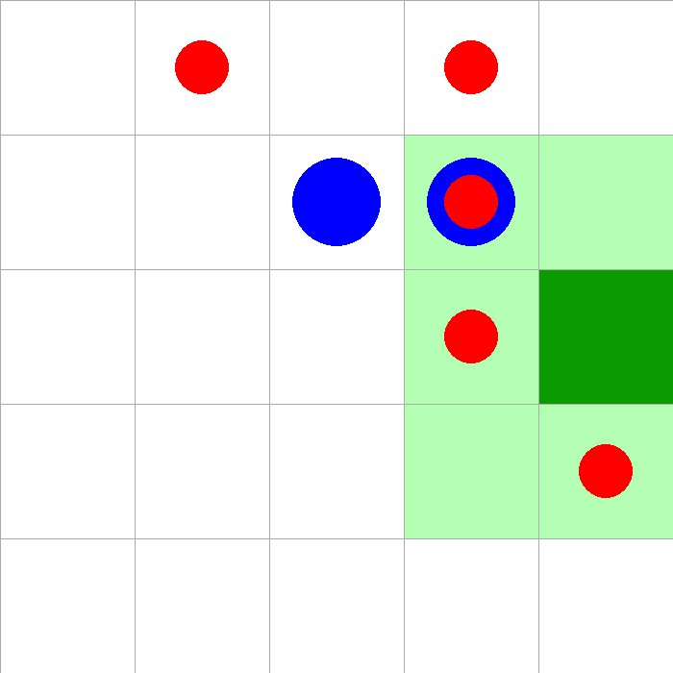

Slide 62
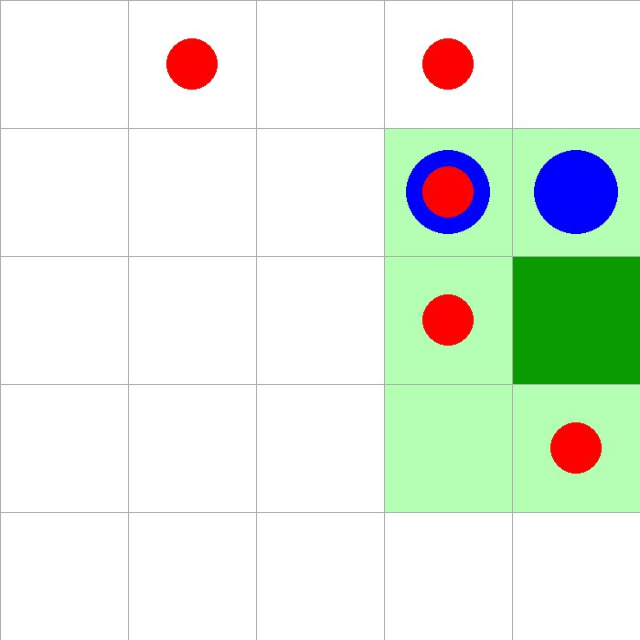

Slide 63
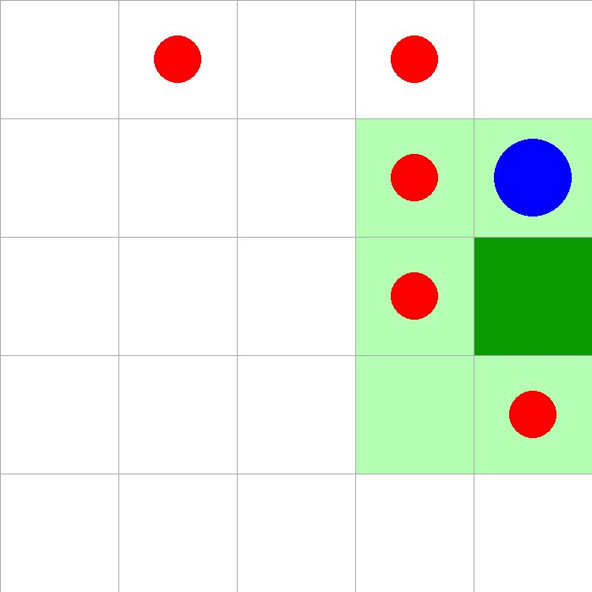

Slide 64
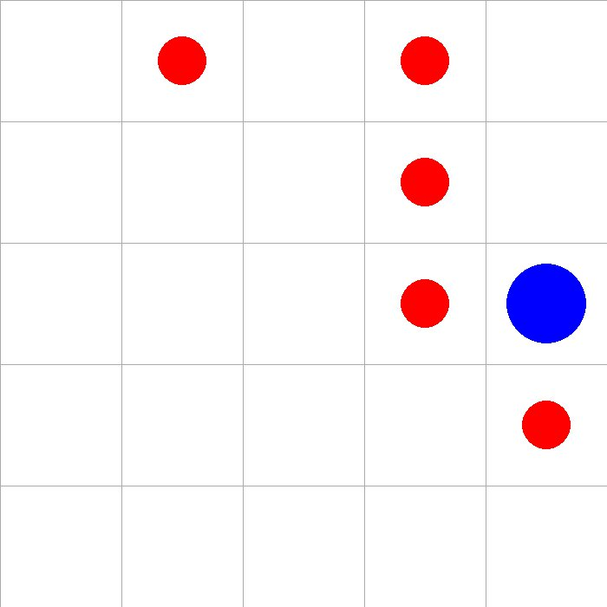

Slide 65
In a nutshell
Resource extraction game
MARL to SARL
DQNs
Normalization
Lazy agents
Exploits
Beyond 5-by-5 grids?
Distributed learning & execution

Slide 66
Questions?

